Slide 1
iverilog Installation and Execution Instruction

Slide 2
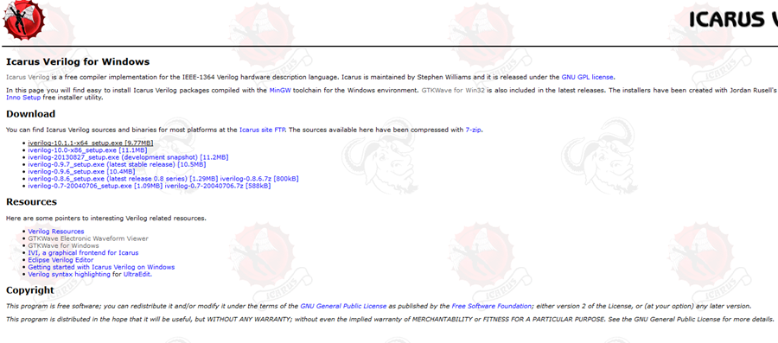
http://bleyer.org/icarus/

Slide 3
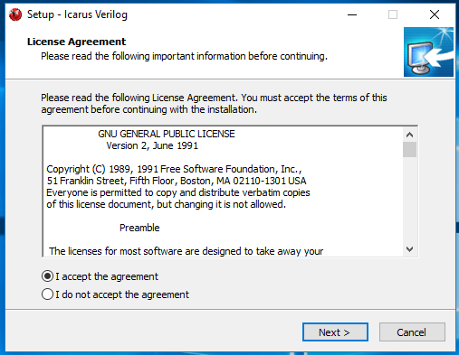
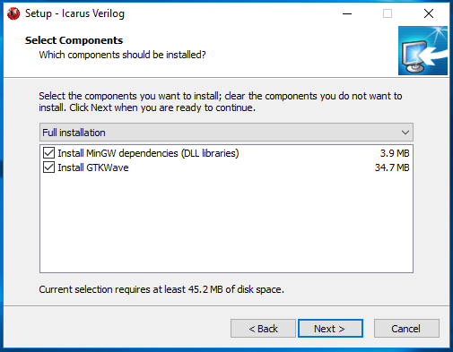
Install the iVerilog Setup

Slide 4
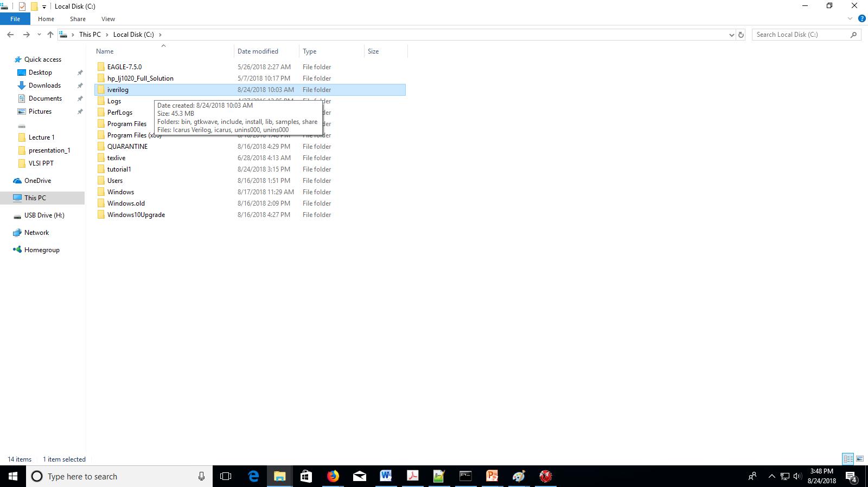
Look your installed file in C drive

Slide 5
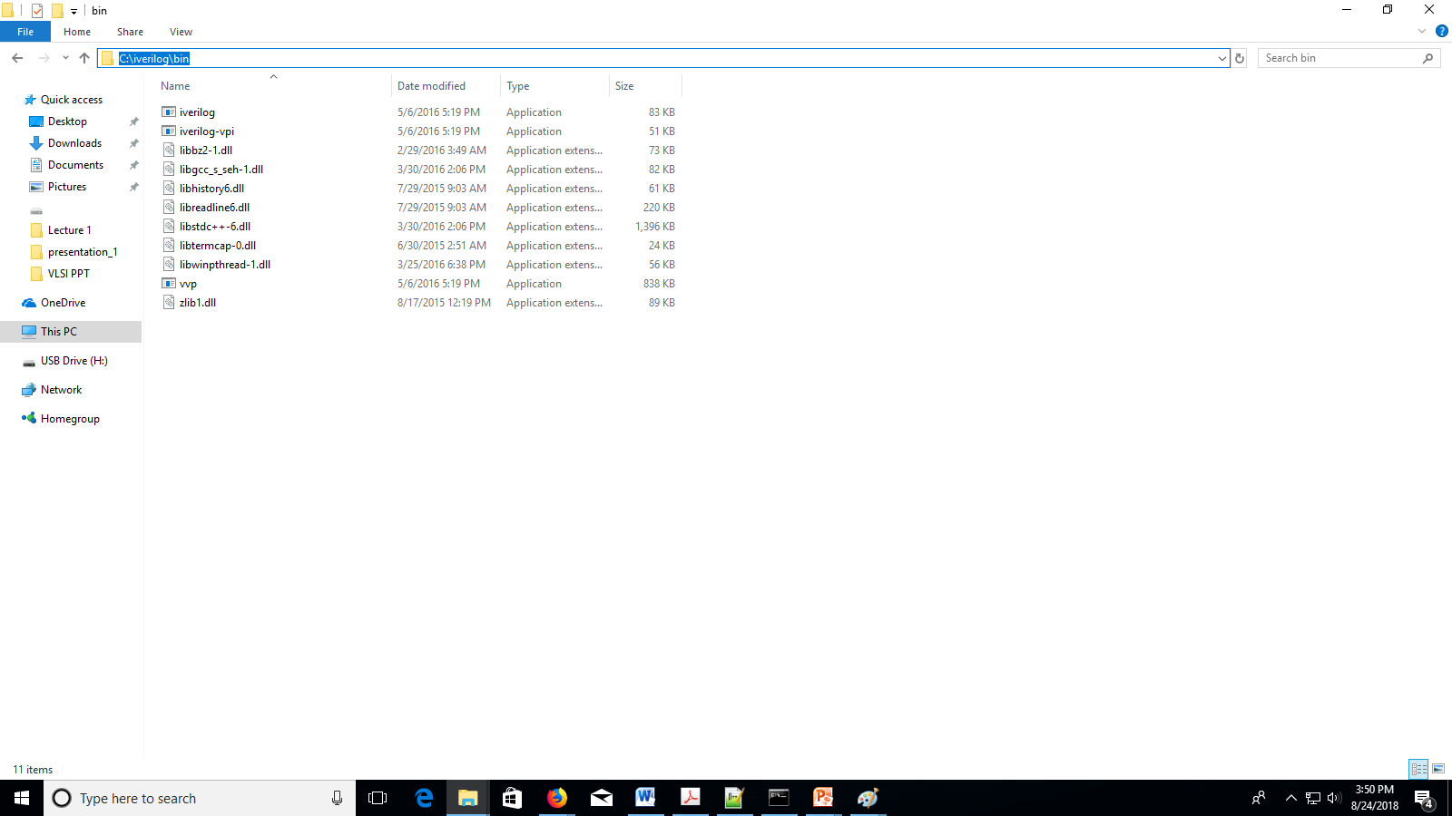
1: Go to directories C:\iverilog\bin
2: Copy the path to set environmental variable

Slide 6
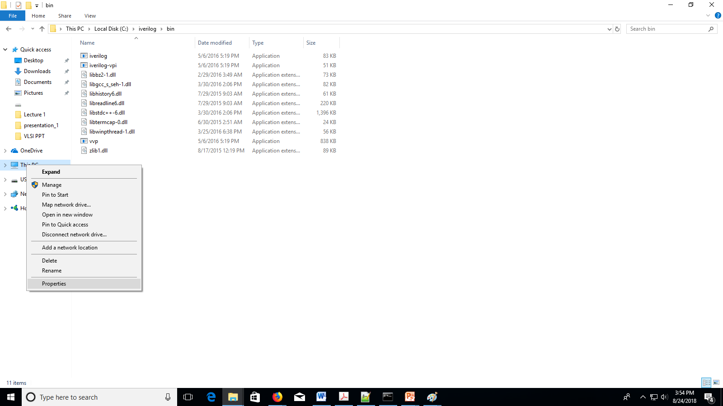
To set environmental variable follow the procedure

Slide 7
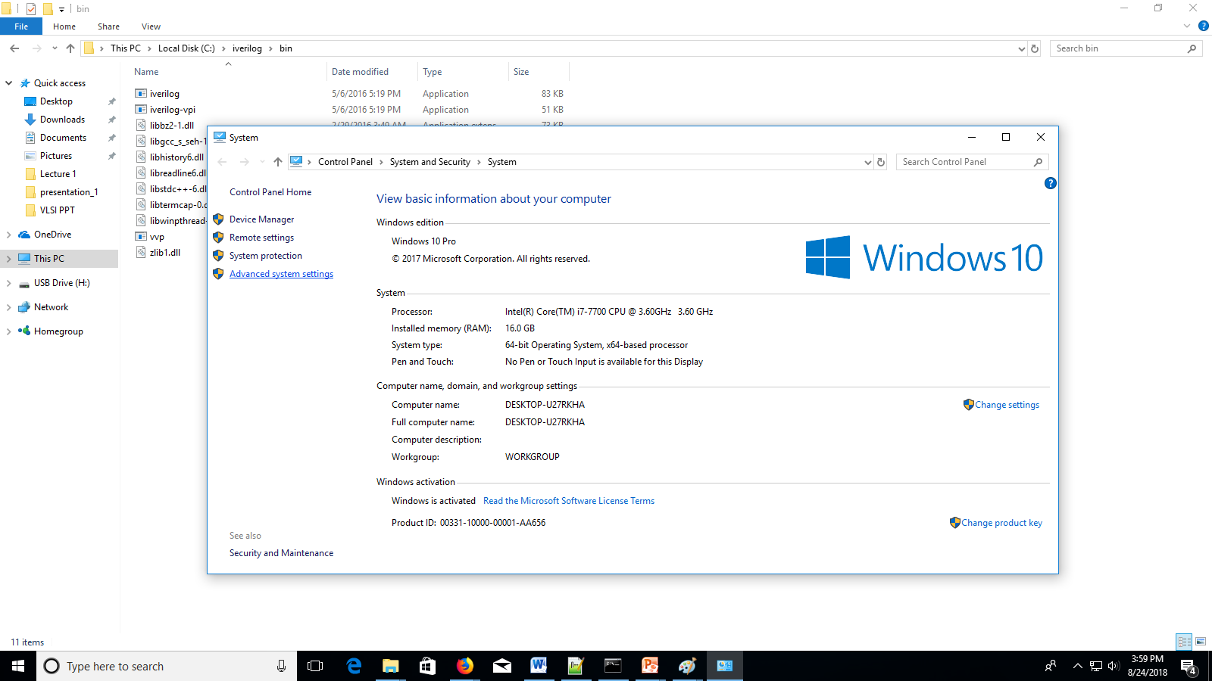

Slide 8
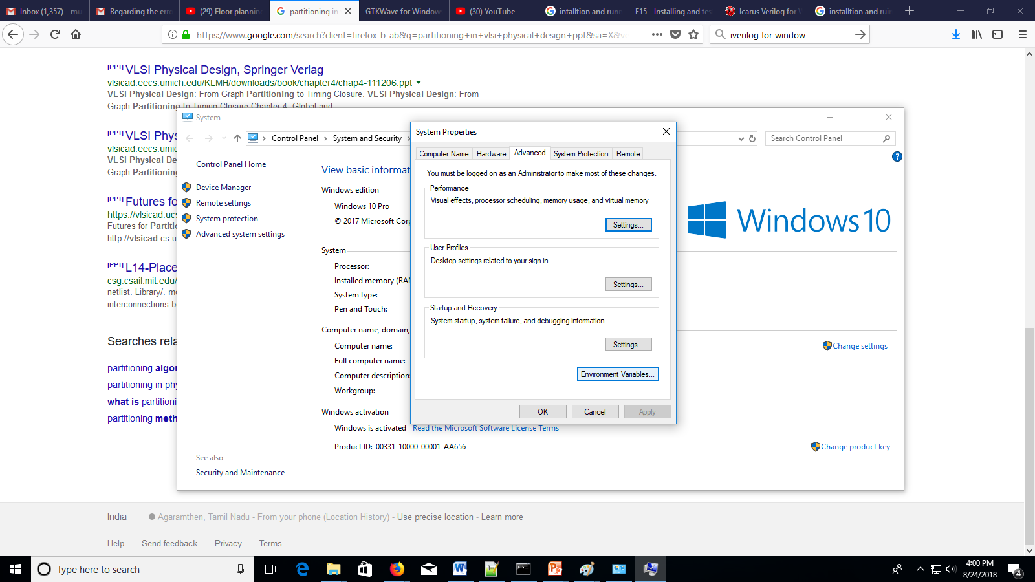

Slide 9
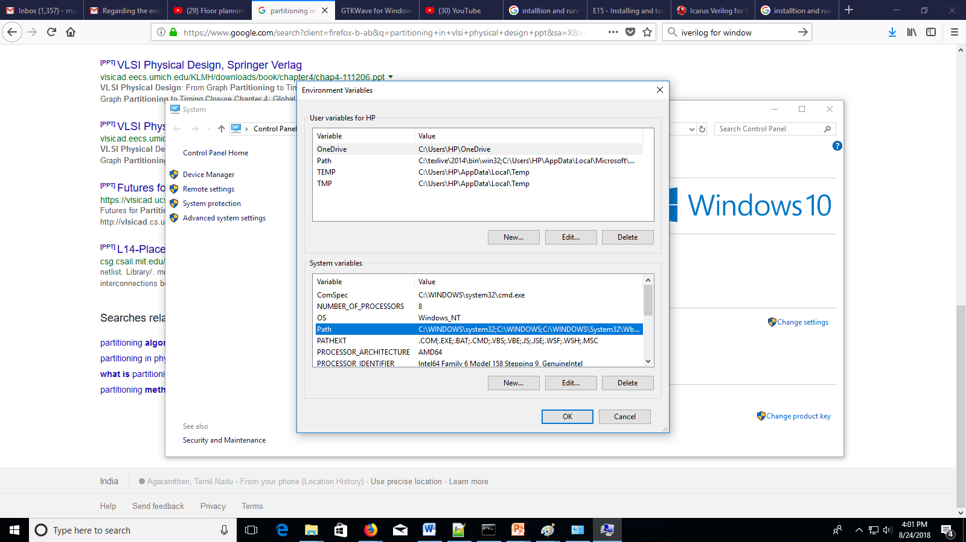
Double click on the Path

Slide 10
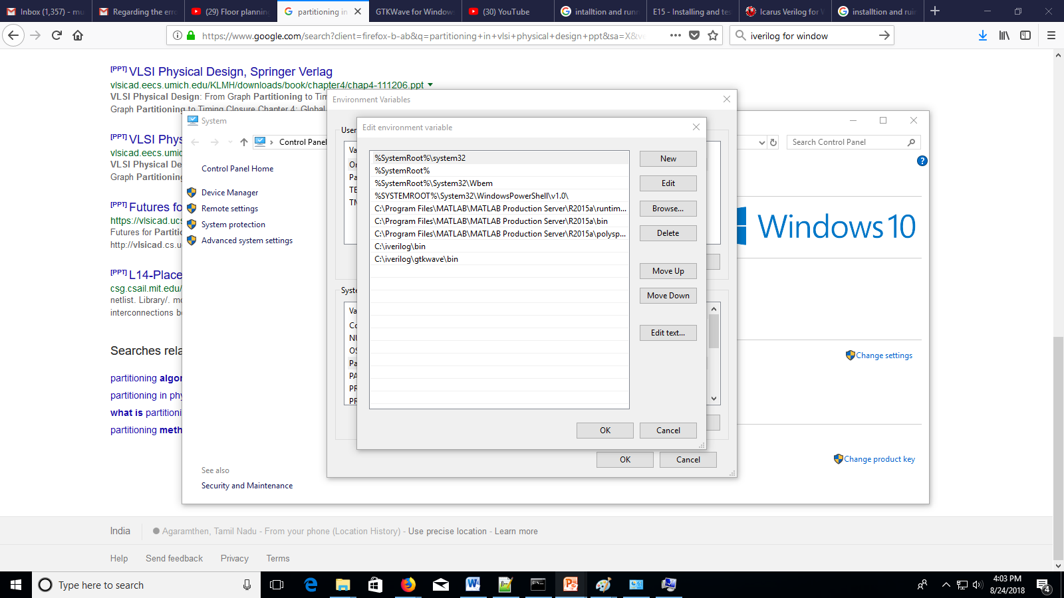

Slide 11
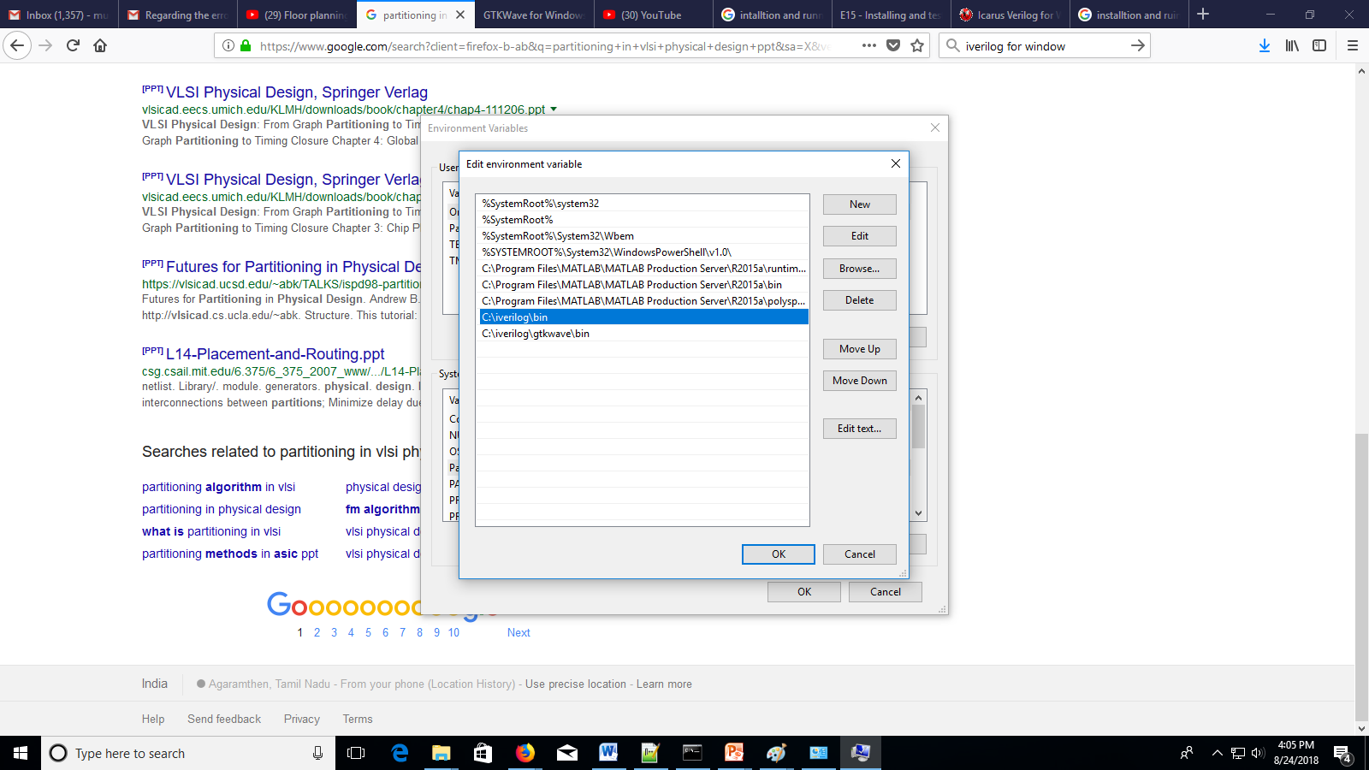
Add the copied location of bin folder C:\iverilog\bin
Similarly Copy the GTKwave bin folder C:\iverilog\gtkwave\bin

Slide 12
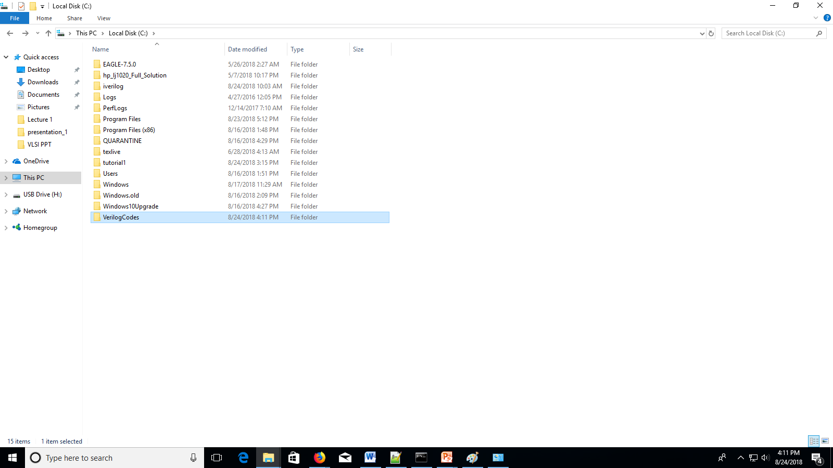
Create a folder to save your Verilog codes

Slide 13
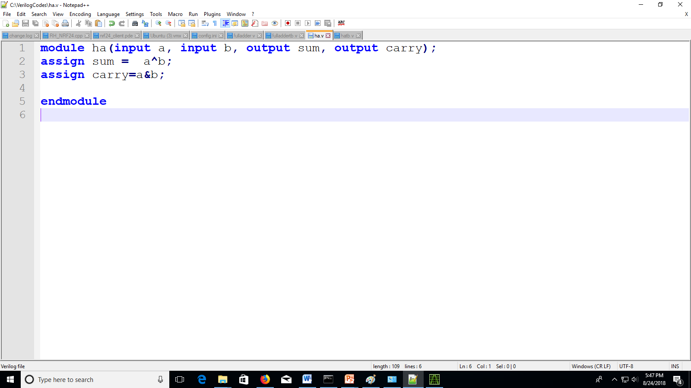
Write the Verilog code using any text editor and save the file with .v extension in your project folder

Slide 14
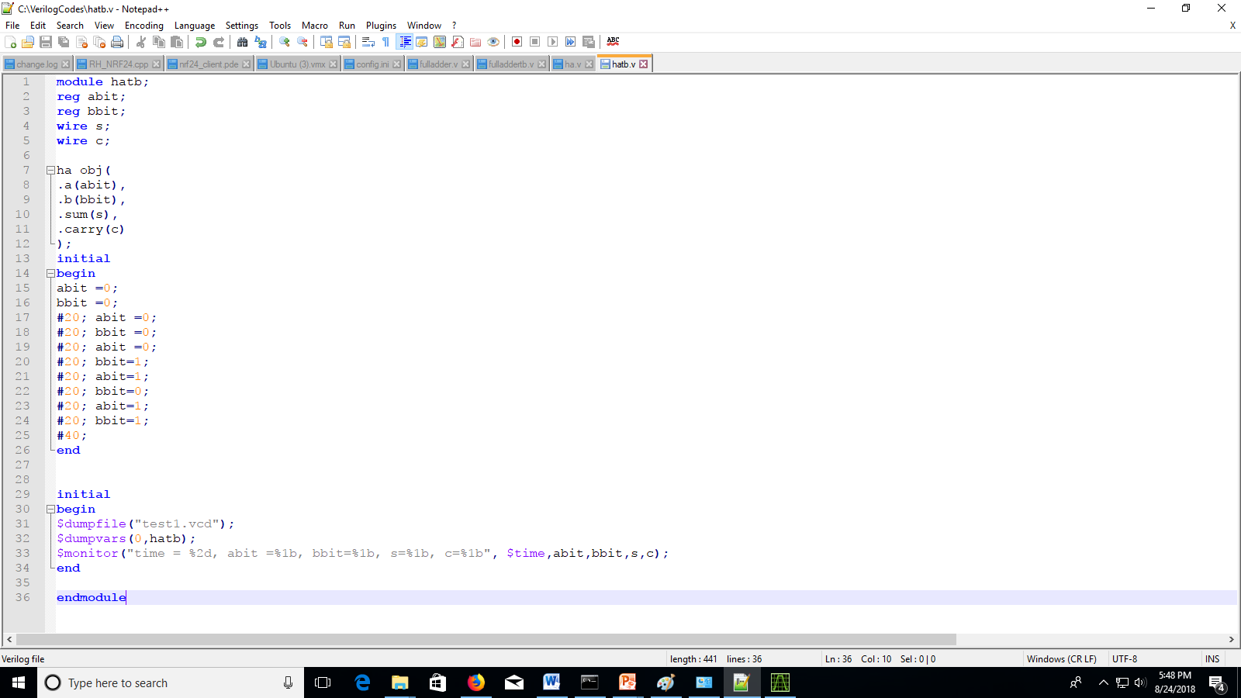
Write the Verilog test bed and save in the similar folder
This is output GTKwave file VCD
This is the name of you test bed file name
This is additional line of code
you have to write for simulation file
Monitor similar to printf in c (it will print all the input output variable content

Slide 15
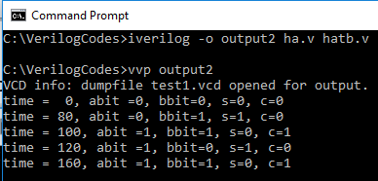
Output file
Main verilog file
Follow the compilation process
This is testbed file
The above command generate the output2 file
This command generate the VCD file in the project folder with the name you mentioned in your hatb.v

Slide 16
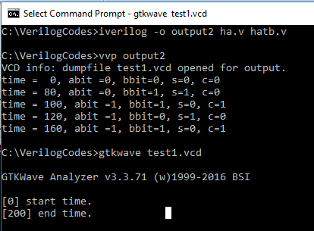
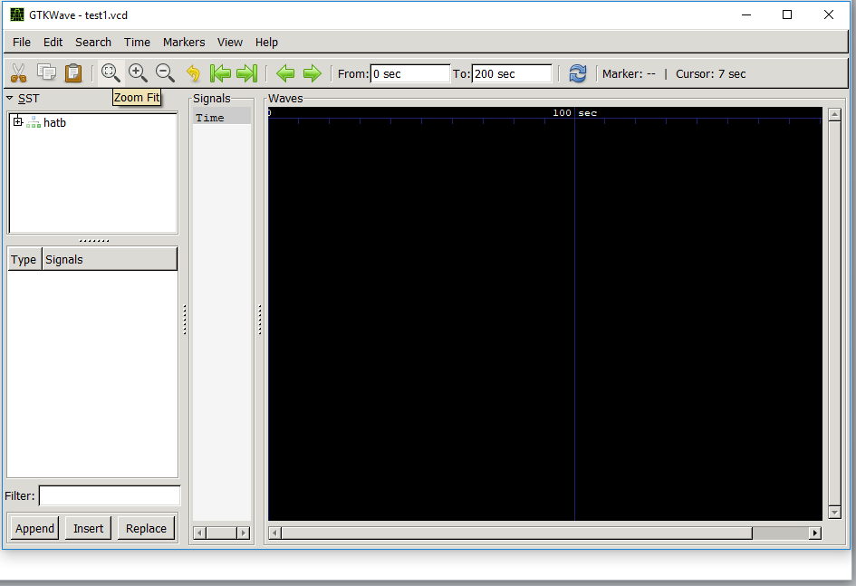
View the VCD file on GTKwave

Slide 17
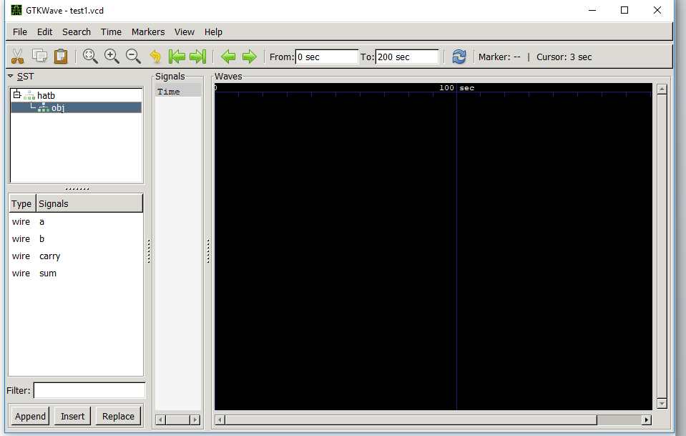
Add all input and output component to few the pulse waveform

Slide 18
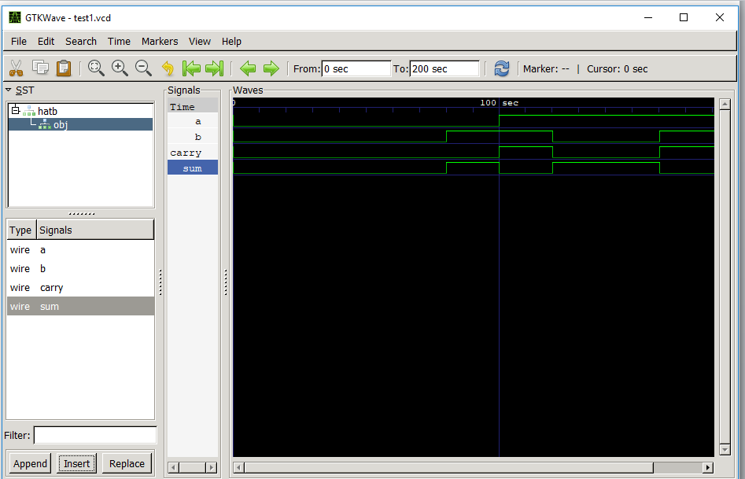
Add the input output component one by one using insert button on GTKWAVE GUI

Slide 19
Go to this link and understand the compilation process of your Verilog code
http://www.swarthmore.edu/NatSci/mzucker1/e15/iverilog-instructions.html
Read few basics of Iverilog
http://referencedesigner.com/tutorials/verilog/verilog_05.php

